Slide 1


Drug/Device Product Development and Regulation – Europe and US “From the lab bench to the bedside – a fantastic voyage of drug/device development”
Swiss Federal Institute of Technology, Lausanne (EPFL)
August 22 to September 30, 2022

Slide 2
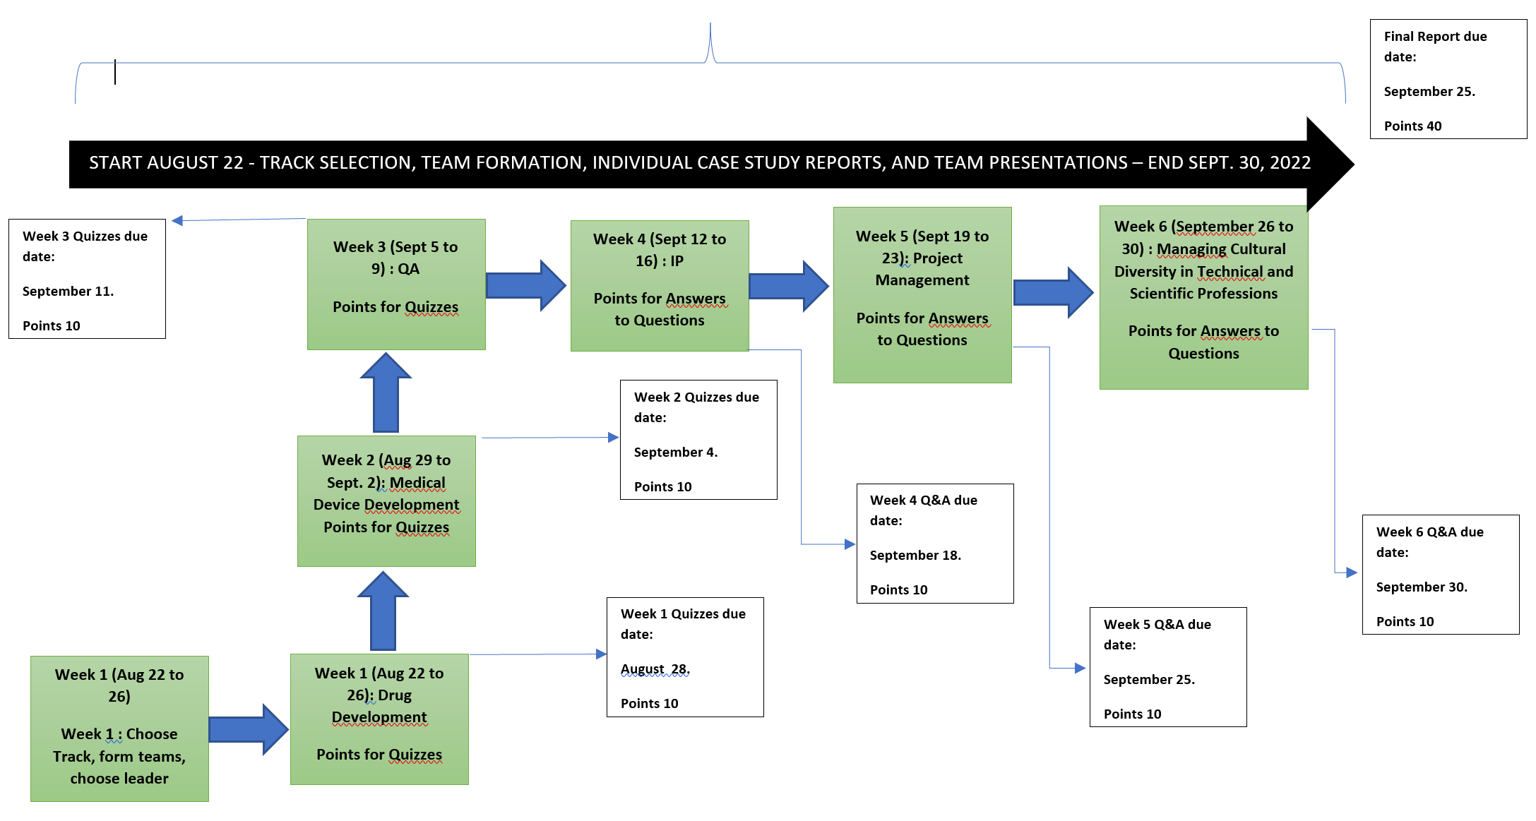
Drug/Device Product Development and Regulation - Europe and US Structure of the course
Open Zoom Session with Instructors on generally on Thursdays of each week from 18:00 CET for about 2h. (see dates and times on program)

Slide 3
Drug/Device Product Development and Regulation - Europe and US Goals and Objectives
The 10 Course Goals and Objectives: Students who successfully complete this course will be able to:
1. Understand the major steps of the drug and device development process through cross-functional teamwork and report writing with pre-set deadlines, reflecting real-life situation of challenges at work in industry.
2. Compare and contrast US and European Union regulatory and quality requirements (major markets setting best practices and standards).
3. Develop tools to interaction with regulators.
4. Understand the basics of a Quality Management System.
5. Develop a Product Profile for a drug/device product or therapy.
6. Draft the basic components of a Development Plan for a Phase 1 clinical trial, including a Preclinical Plan, a Clinical Trial Protocol, and CMC (Chemistry, Manufacturing and Controls) Plan.
7. Master the basics of early stage Project Management skills.
8. Learn the essentials of Intellectual Property Rights.
9. Learn the art of successful cross-cultural communication.
10. Feel more confident about job seeking and job interviews

Slide 4
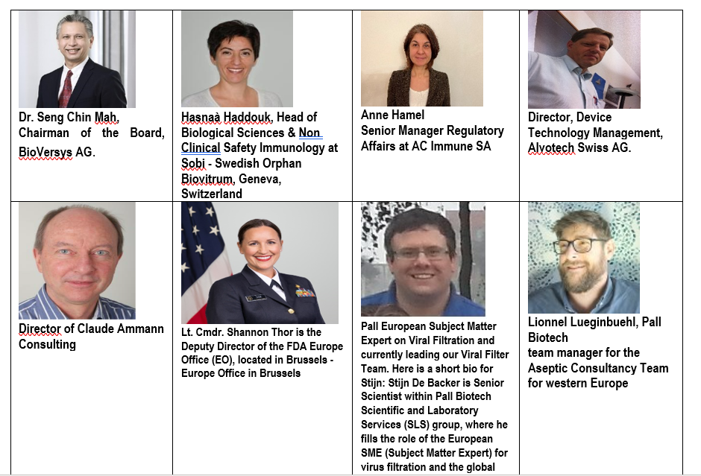
Drug/Device Product Development and Regulation - Europe and US Faculty/Instructors

Slide 5
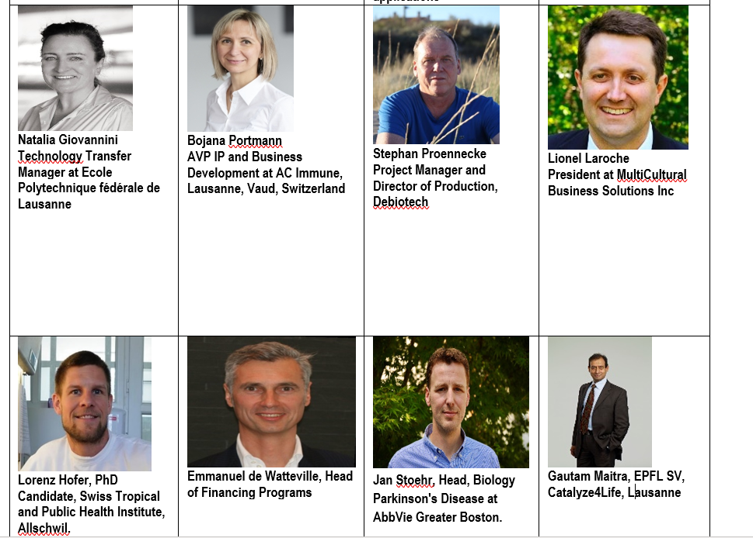
Drug/Device Product Development and Regulation - Europe and US Faculty/Instructors (Contd.)

Slide 6
Drug/Device Product Development and Regulation - Tasks for Students
A week begins on a Monday and ends on Friday.
Decide on the track – Drug or Medical Device, form teams, choose team leader: due date Sunday Week 1.
By choosing the track you are expected to adhere to the corresponding Case Study (Drug or Medical Device), its report and presentation, all other tasks & actions are remain same for all.
All students will individually complete the weekly quizzes on time.
All students will actively give the required inputs and work actively with the team leaders for the team leader PowerPoint presentation.
All students should complete the Individual Case Study Resport (ICSR): due date Wednesday Week 6.

Slide 7
Drug/Device Product Development and Regulation - Europe and US
Thank you
- Gautam Maitra
Email: gautam.maitra@epfl.ch
Mob: +41 79 4395956

